Slide 1
Revenue of AUTOMOBILE PARTS In USA

Slide 2
Total Revenue Sales Per Year
This AXIS GRAPH represents the sum of the revenue sales happens in the year from 2018-2019. According to the given data, as you can see in the month of March of year 2019 the sum of revenue is at the peak position which is 127k.

Slide 3
Given pie-chart represents the items which has been sold many times. According to the data, item 5 is sold many times compare to other product in both the years from 2018-2019.

Slide 4
The Vertical bar chart diagram helps you to understand How much Sales perform by the employees in each Year by filtering the Year

Slide 5
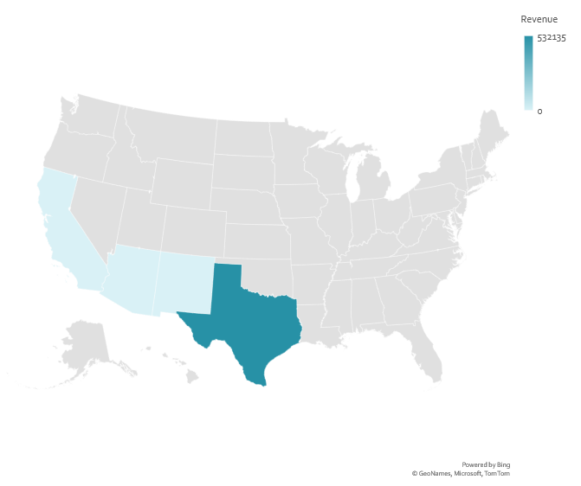
This Map Diagram helps you to analysis the revenue for the particular by simplify looking at the map of the region instead of checking the data

Slide 6
This horizontal axis bar graph represents the Total Revenue Performed by each company. The Y-axis represents the company names, and the X-axis represents the Total revenue each company has made it.

Slide 7
Texas Year 2019 Vs 2018
In the Year 2019, in the month of May Texas has made total revenue of 33k although in the month of May in 2018 Texas has touched the Revenue of 40k which all time high compared to the other Regions.

Slide 8
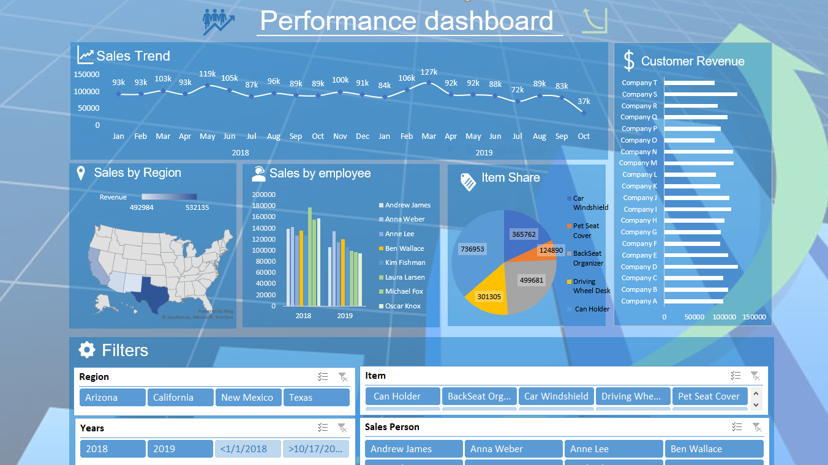

Slide 9

Thank You

